Slide 1

INDUSTRIAL TRAINING IN THE SPARKS FOUNDATION FROM 01-07-2021 To 01-08-2021
A
Presentation
Submitted
In partial fulfillment
for the award of the degree of
Bachelors in Computer Application
(with specialization in Android App Development)
Supervisor:-
Rishank Sharma
Assistant Professor
Submitted By:-
Kunal Jain
Enrollment no.:
19CA151M50T011

Slide 2
TABLE OF CONTENTS
Company Profile
About Grip
Responsibilities
Programming Languages Used
Introduction of Topic
Assigned Project
Challenges Faced During The Internship
Bibliography

Slide 3

COMPANY PROFILE
THE SPARKS FOUNDATION
The Sparks Foundation. This brand new education non-profit trying to sell students hope for successful future. This internship program is based completely online as a part-time internship for students. GRIP offers internships for the areas of tech, marketing, and human resources.

Slide 4
ABOUT GRIP
The Global Research Programme on Inequality (GRIP) is a radically interdisciplinary research programme that views inequality as both a fundamental challenge to human well-being and as an impediment to achieving the ambitions of the 2030 Agenda.

Slide 5
RESPONSIBILITIES
Creating and/or developing dynamic websites with various specifications.
Work on features such as Payment Gateway Integration.
Work on skills such as HTML , CSS , JavaScript , Bootstrap etc with guidance .
Build a strong professional profile , present given tasks and submission .
Collaborate and coordinate with fellow team members and mentors.

Slide 6





PROGRAMMING LANGUAGES USED
HTML
EDITOR : VISUAL STUDIO CODE
JAVASCRIPT
CSS
BOOTSTRAP

Slide 7
INTRODUCTION OF TOPIC
PAYMENT GATEWAY INTEGRATION
A Payment Gateway Integration is the payment option between the sender and the receiver.
PAYMENT GATEWAY WHICH I USED IS ROZORPAY
Rozorpay gives you access to all payment modes including
Credit card
Debit card
Net banking
UPI
Wallets

Slide 8
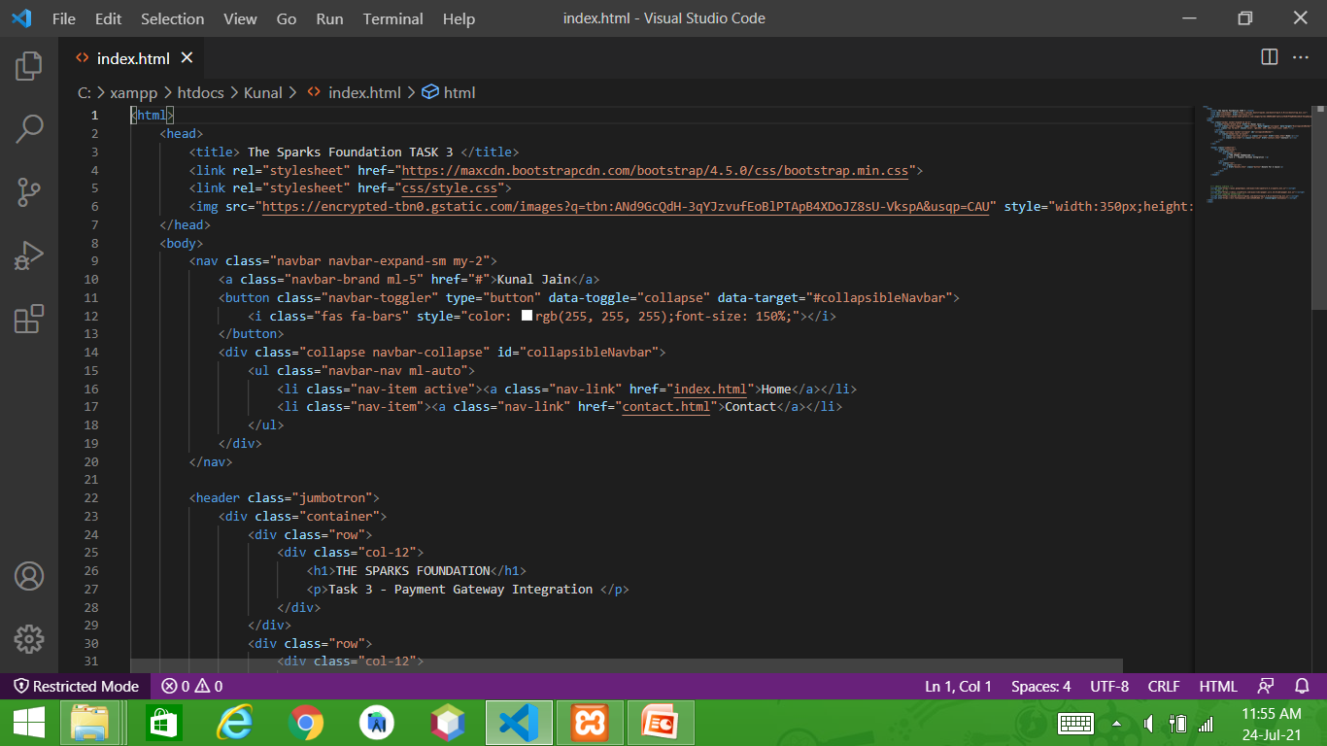
ASSIGNED PROJECT

Slide 9
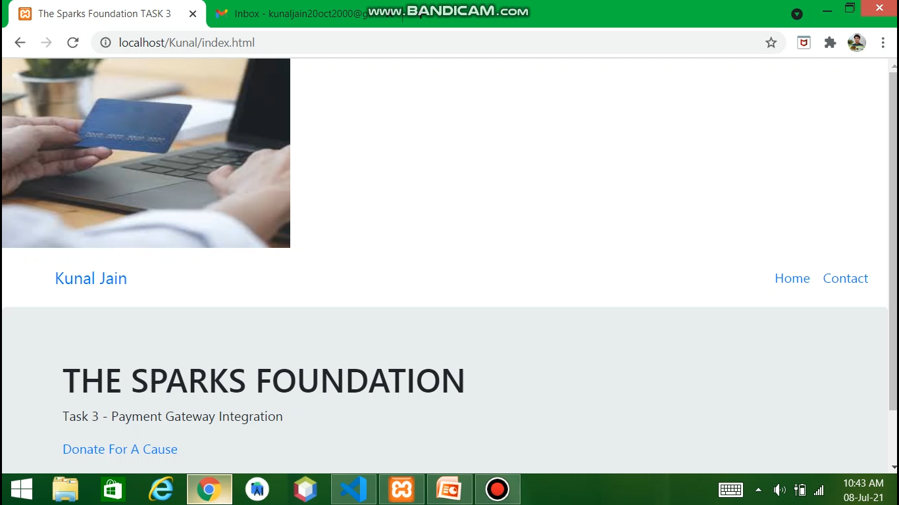
HOME PAGE

Slide 10
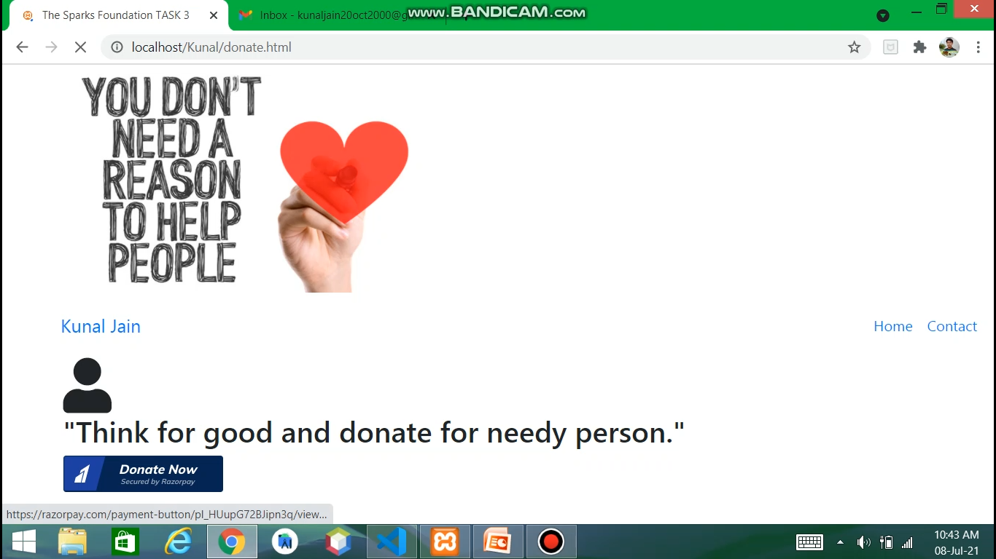
DONATE NOW

Slide 11
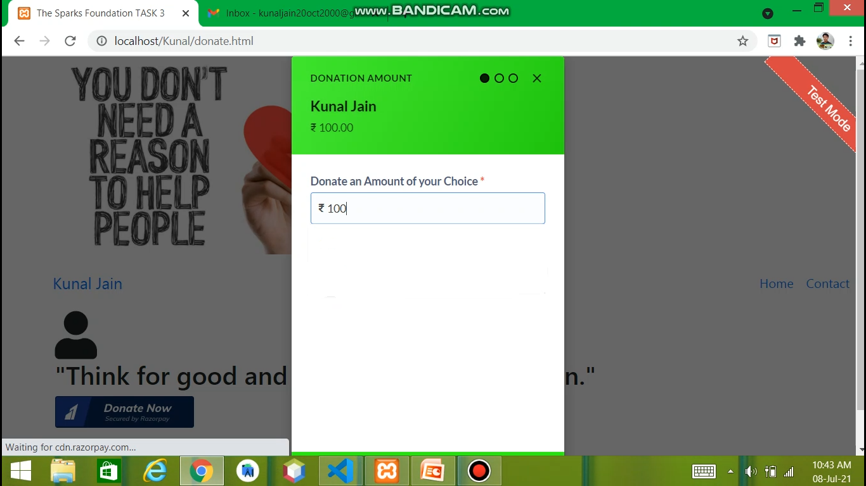
DONATE AMOUNT

Slide 12
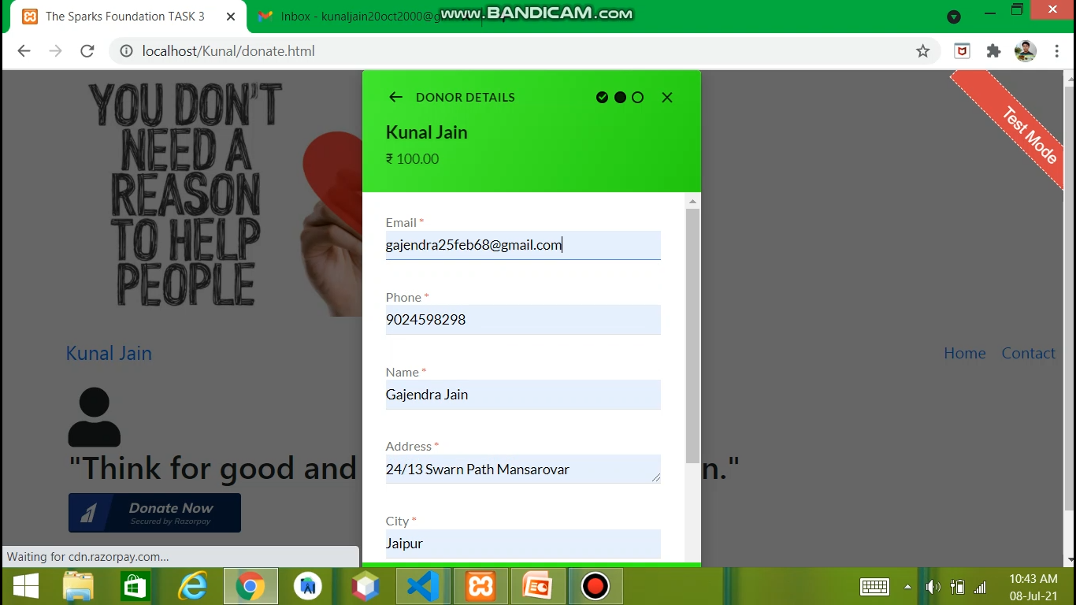
DONOR DETAILS

Slide 13
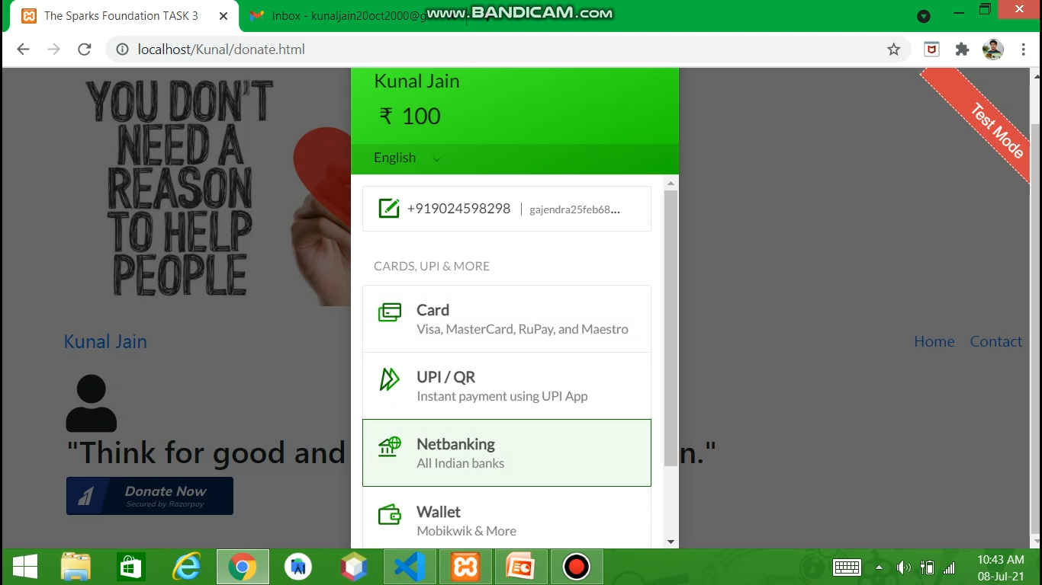
PAYMENT OPTION

Slide 14
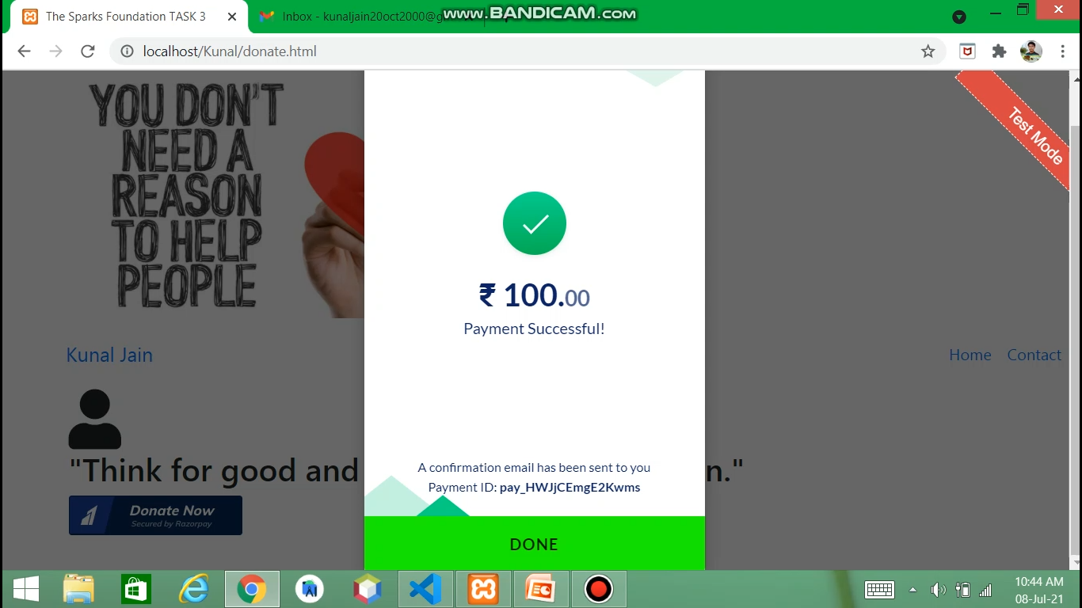
PAYMENT SUCCESSFULL

Slide 15
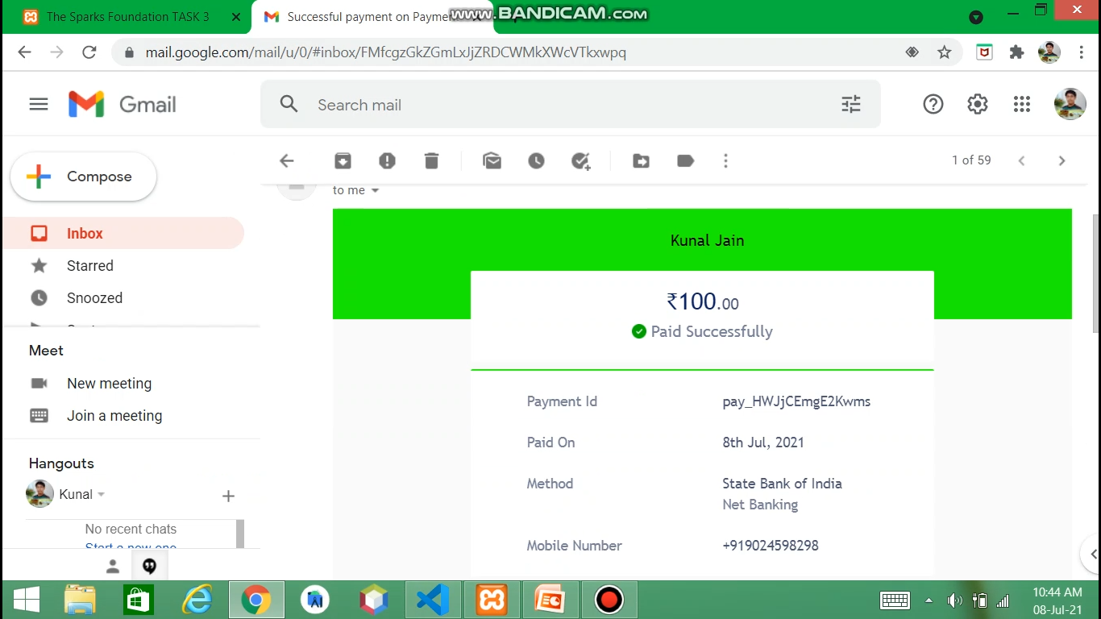
MAIL

Slide 16
CHALLENGES FACED DURING THE INTERNSHIP
Competition with other interns.
Internet Connection.
The MyCredibleInfo takes very much time to complete its verification process.

Slide 17
BIBLIOGRAPHY
Google Chrome
You tube
LinkedIn

Slide 18


